Slide 1
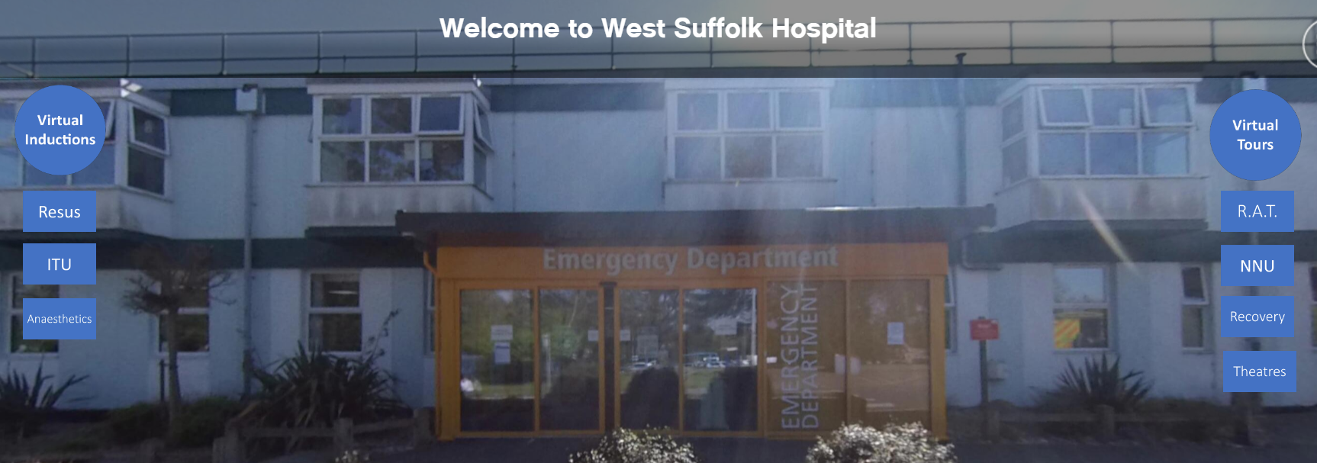
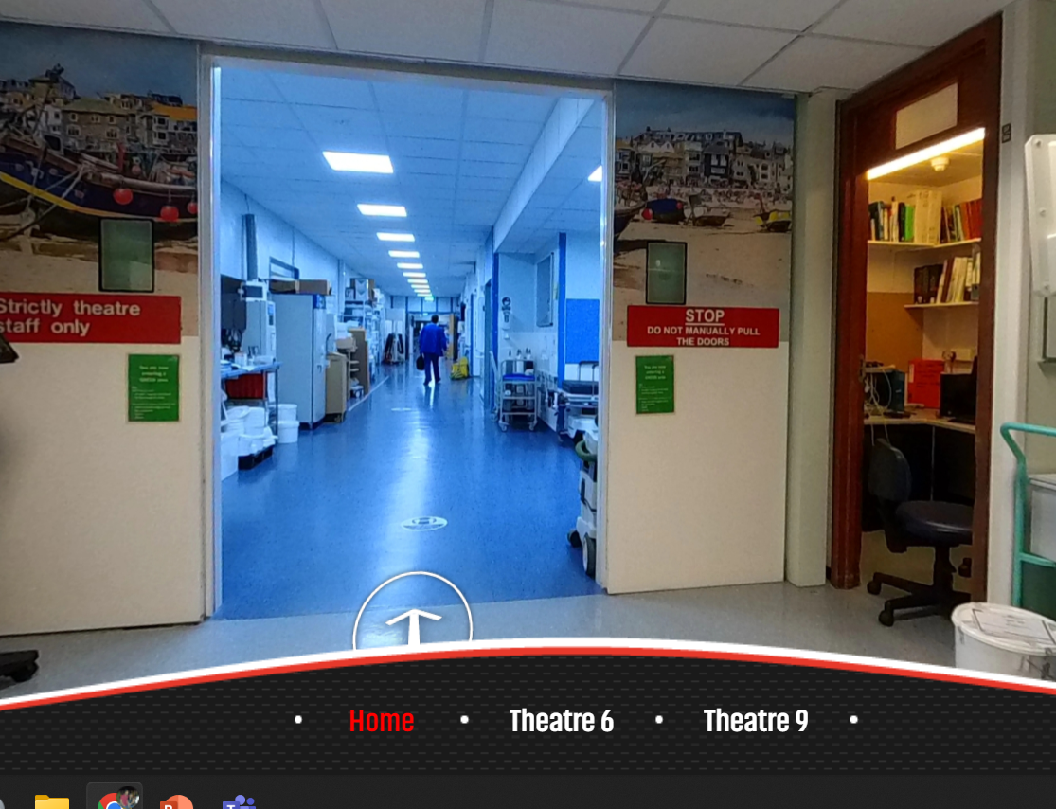
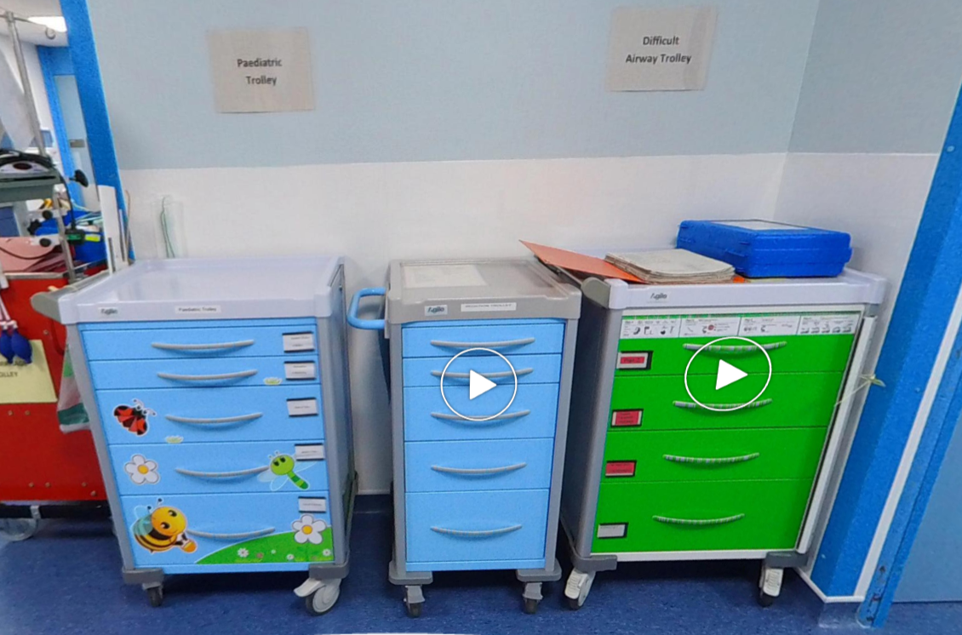
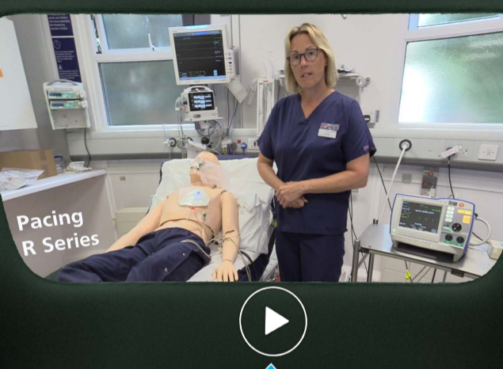
Virtual Induction for new doctors in a District General Hospital Dr Rashida Lokhandwala¹, Charlie Gienke², Dr Rayyan Anwar¹, Dr Kaushik Bhowmick¹ 1) Department of Anaesthesia, West Suffolk Hospital NHS Foundation Trust 2) Department of Digital Services/PGME, West Suffolk NHS Foundation Trust
Introduction:
UK trainees rotate between hospitals regularly throughout their career. We felt that a 360° video tour of the department would be a significant improvement from traditional face-to-face induction. Swerdlow et al¹ highlight the advantages of screen-based simulation as ‘cost, availability, simplicity, repeatability and scorability’.
Our project:
We took a series of 360° photos in our theatre complex to create a virtual induction which included:
a tour of the theatre complex
locations of key equipment e.g. difficult airway trolley
We created videos and information points to include within the tour which aid:
familiarisation with equipment used in our trust
familiarisation with the electronic medical records used in our trust
We then created a website (scan QR code) to upload these photos and videos and the link to this website would be shared with all new trainees as a part of their induction pack.
Screenshots:
Results:
10 invited for survey
7 responded
7 Virtual induction helpful with induction/familiarisation
7 Felt more confident with equipment use after watching the videos
West Suffolk Hospital- main entrance
Conclusion:
We received very positive feedback for this novel method of induction and have shown that this high-fidelity induction programme could be used to help with familiarisation of the working environment for new trainees. The platform provides an easy and convenient form of induction and aids continuous reinforced learning through video-based material which could be used alongside face-to-face induction.
Theatre complex- main entrance
Theatre
Reference: 1) Swerdlow B, et al. Distance Education in Anaesthesia using Screen-based Simulation- A Brief Integrative Review. Adv Med Educ Pract. 2020;11:563-567.
Location of key equipment
Familiarisation with equipment
Live website: https://wsheducation.co.uk/

